Slide 1
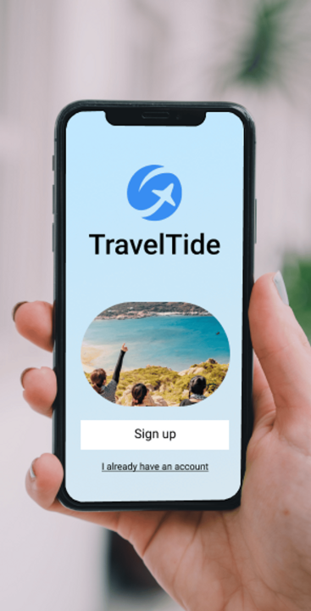
Segmentation Analysis for Reward Program Enhancement
Dokleat Halilaj
Masterschool, April 2024

Slide 2
Context
Perks
Free Checked Bag
Free Cancellation
Free Hotel Meal
One Night Free Hotel With
Flight
Exclusive Discounts
Users
Users that had more than 7 sessions
Between 04/01/2023 and the most recent available date.
Aim
Utilise K-Means algorithm
to identify and cluster
unique user segments
based on user preference.

Slide 3
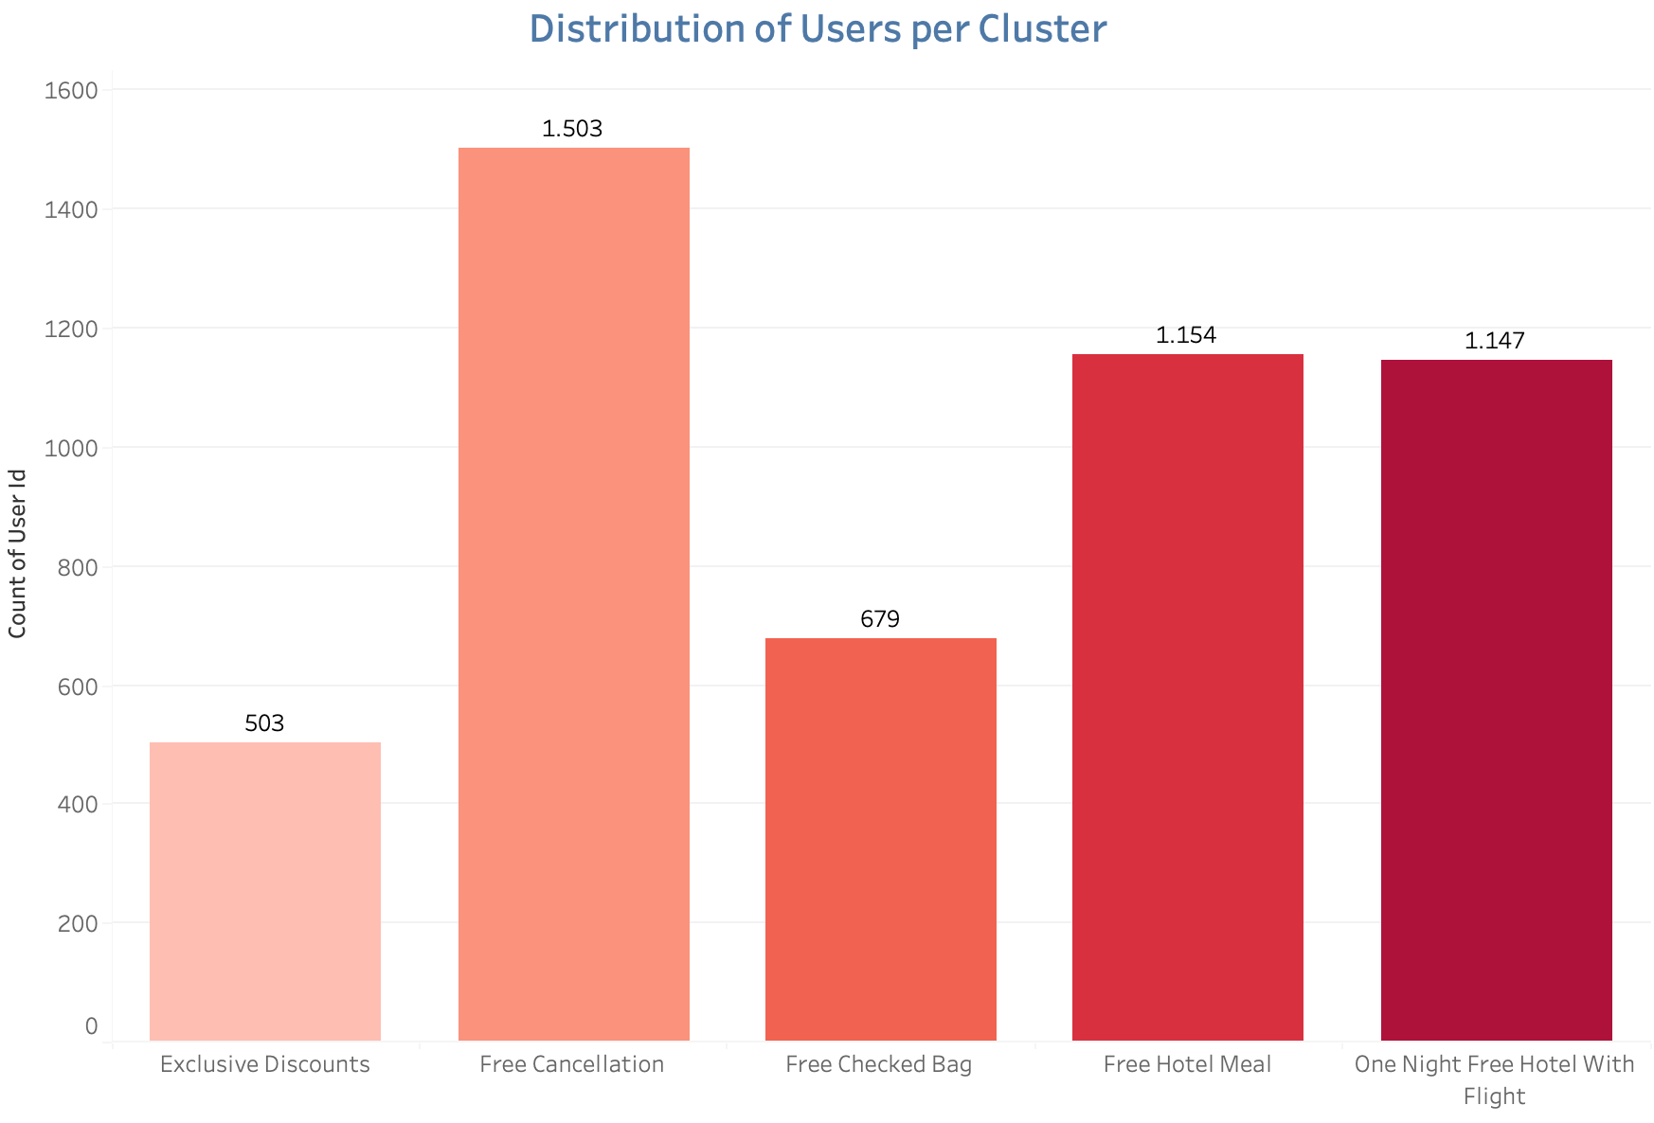
Findings
Insights: "Exclusive Discounts" cluster values cost-effective bookings. "Free Hotel Meal" prefers dining perks. "Free Checked Bag" shows baggage interest.
Cluster Sizes: "Exclusive Discounts” (bargain hunters) is smallest. "Free Cancellations" (cost-conscious, no cancellations) is largest.

Slide 4
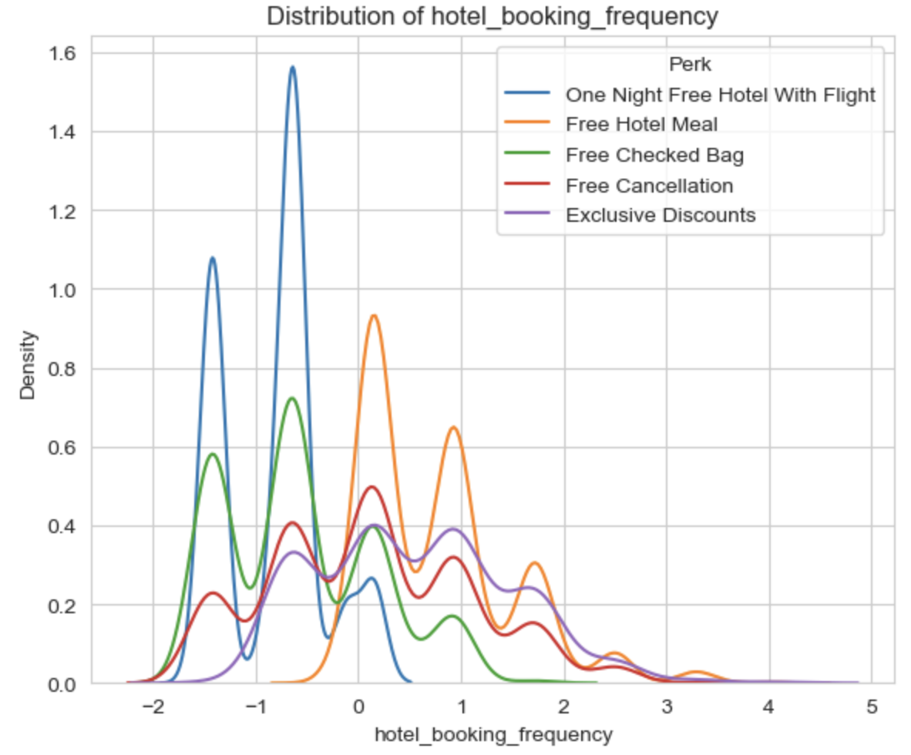
Line Chart: "Free Hotel Meal" larger distribution but overlapping clusters suggest multi-preference users.
Gender Balance: The majority of female users indicate an opportunity for targeted marketing to engage men and diversify the customer base.

Slide 5
Recommendations
Multi-Level Rewards: Implement multi-level rewards catering to customer
engagement stages, capitalising on preference overlaps to boost booking activities.
Consider consolidating perks (”Free Hotel Meal” and “One Night Free Hotel With
Flight”).
Periodic Refinement: Periodically re-segment with a larger dataset for nuanced
segmentation, adapting to changing preferences and improving targeting.
Feedback Mechanism: Collect direct customer feedback for program refinement,
staying relevant and appealing.
Targeted Marketing: Tailor campaigns to cluster preferences, aligning messages and
perks for higher engagement and loyalty.
Gender Balance: Address gender imbalance for a diverse and inclusive customer
base, enhancing program reach and appeal.

Slide 6
Appendix
Access the project's Jupyter Notebook HERE for a detailed analysis.
Explore the SQL query used in the project HERE to understand data extraction and manipulation.
View the interactive Tableau Dashboard HERE to visualize key insights.
Watch the project presentation HERE to dive deeper into the analysis and recommendations.

